Slide 1

Artificial Intelligence
Reinforcement Learning For Line of Actions (Simplified Version)
Realizado por:
Fabio Huang up201806829
Ivo Ribeiro up201307718
Maria Beirao up201806798

Slide 2
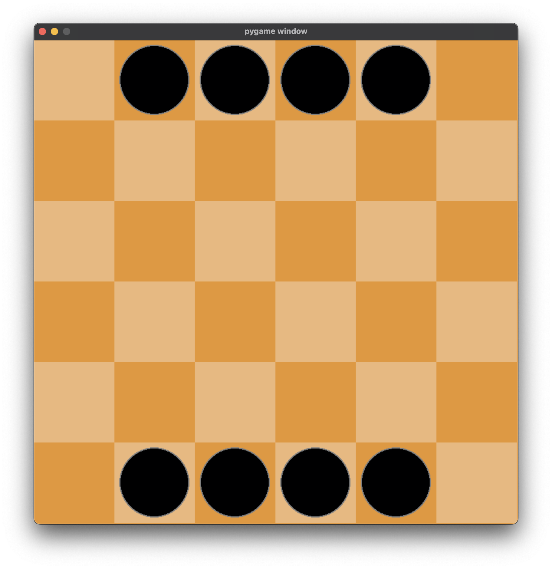
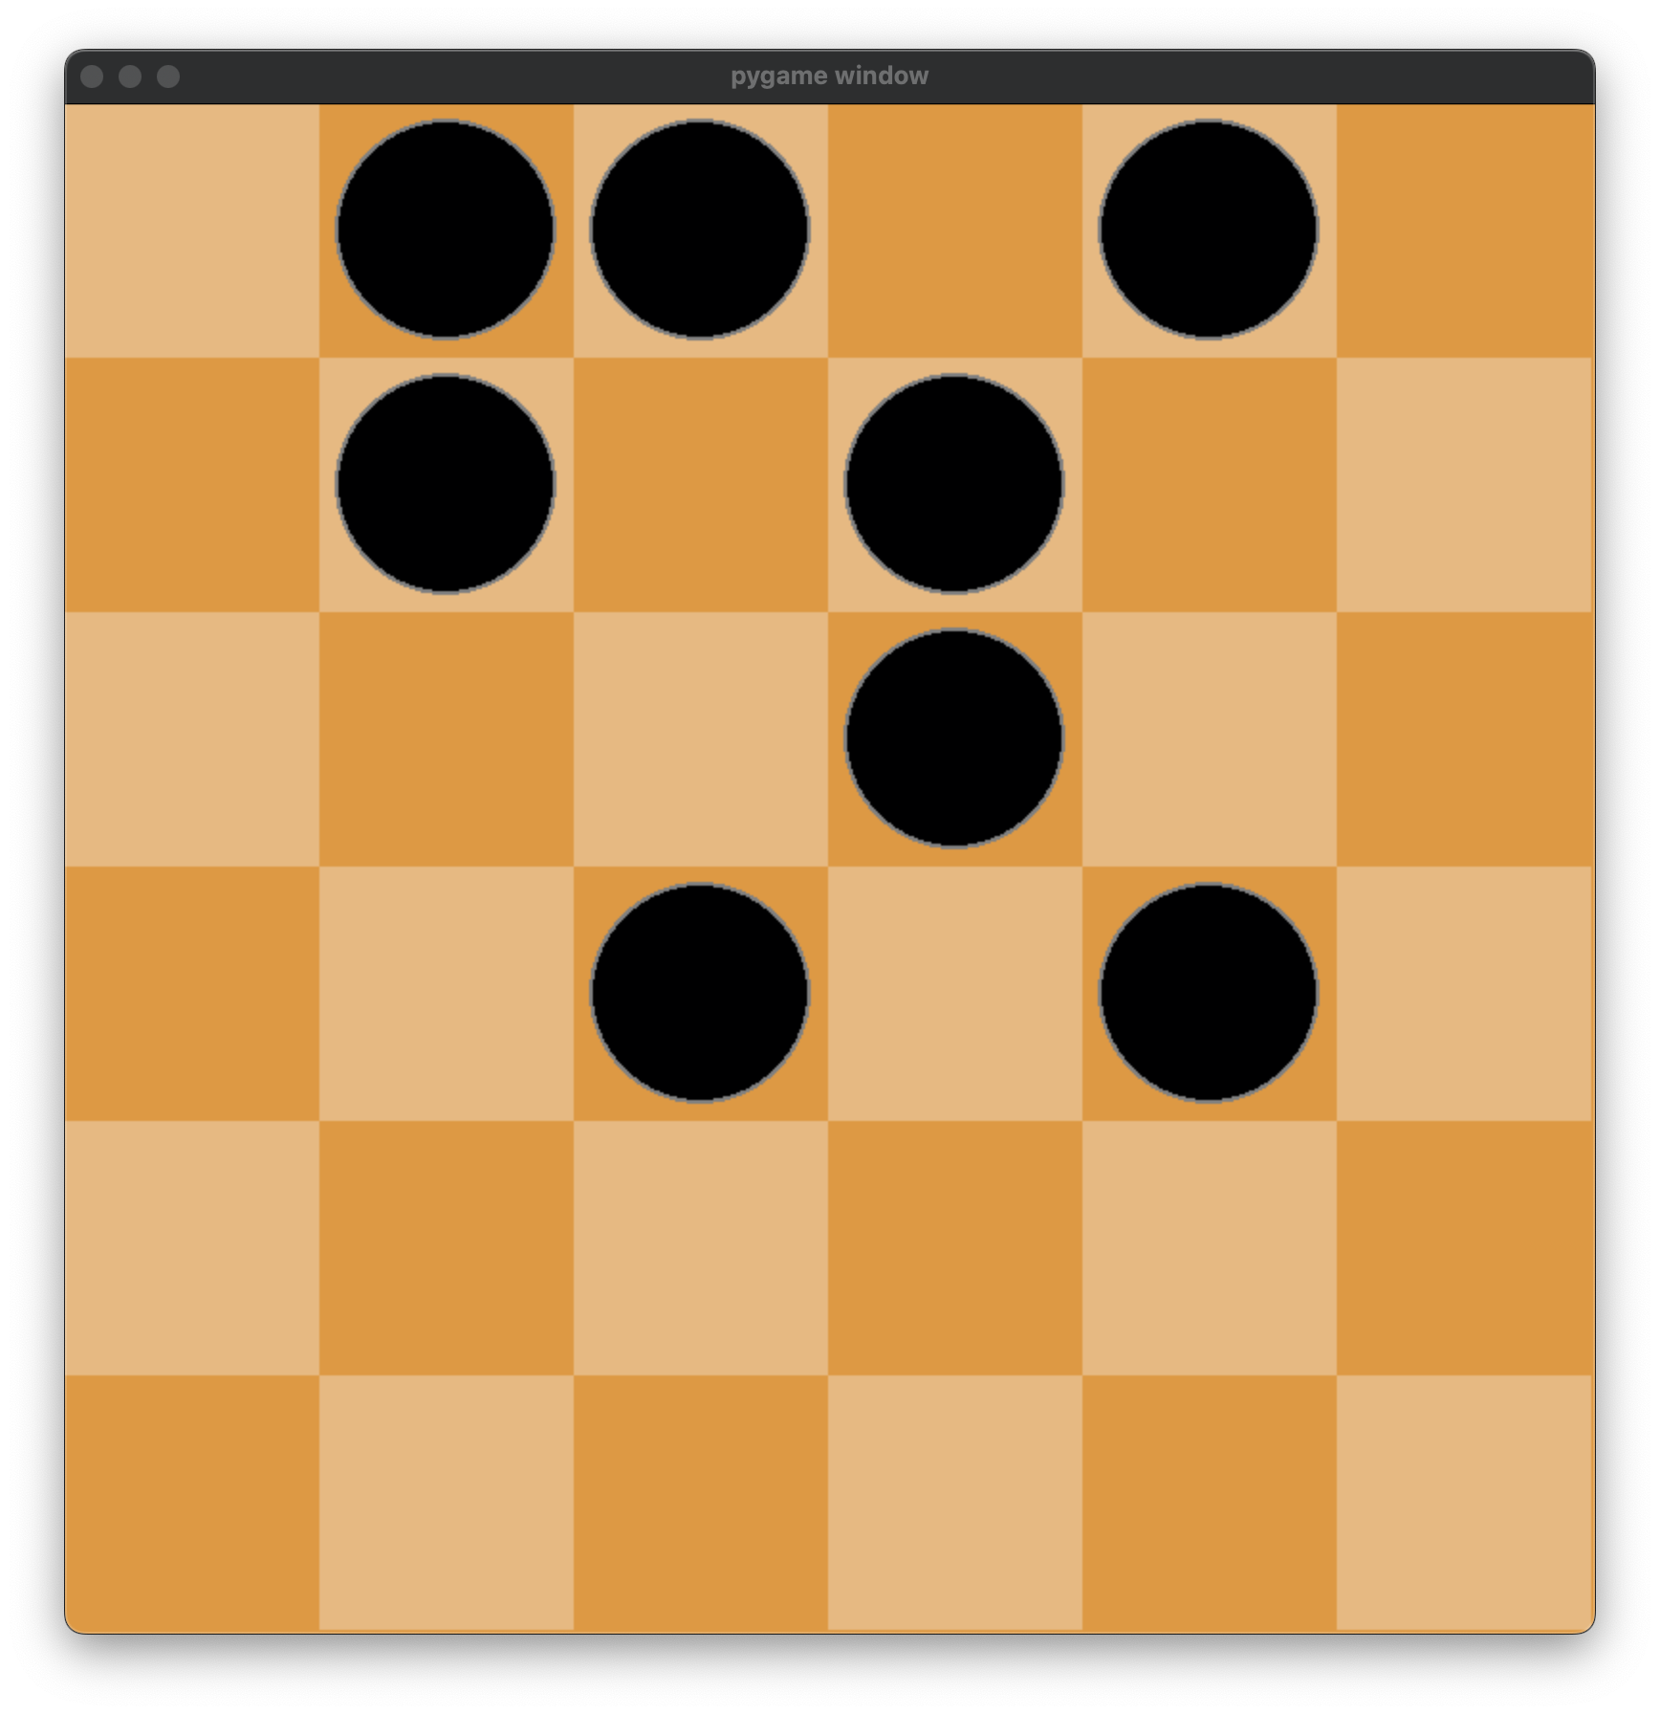
Game Specification
Board and Pieces:
Simple checkers board (NxN)¹
2*(N-2) Black Pieces on the board
Game Objective:
Connect all your pieces together in a group (including diagonals)
Movements:
Every turn one of the pieces should be selected to be moved, in a straight line (orthogonally), exactly as many squares as there are pieces of either color anywhere along the line of movement.
Pieces may jump over their own pieces, but cannot land on them
Fig.1 example of initial state
Fig.2 example of finish state
1. 4x4, 5x5, 6x6 were used for experiment

Slide 3
Tools And Algorithms
To address this reinforcement learning problem we chose the Stable Baselines 3 Library in Python, and we will be using the following algorithms for this experiment:
Proximal Policy Optimization (PPO)
Advantage Actor Critic (A2C)
Trust Region Policy Optimization (TRPO)
In order to execute the API provided by Gym, we will need to implement a custom environment for our game. We created a class LoaEnv, that will inherit the abstract class gym.Env from this package, and declared the following methods:
def __init__(self)
defines the observation space and action space of the environment
action space = discrete space of n*4 (n pieces, 4 directions)
observation space = box space with shape = NxN (N is board size)
def reset(self)
Resets the game (used for every new episode) and returns the initial observation of the board
def step(self, action)
Accepts action (move) chosen by the computer
Reward is also defined here
The resulting Observation, Reward, Game Over Flag are returned
def render(self)
Renders the game (Pygame was used)
def close(self)
Closes the environment and terminates anything if necessary

Slide 4
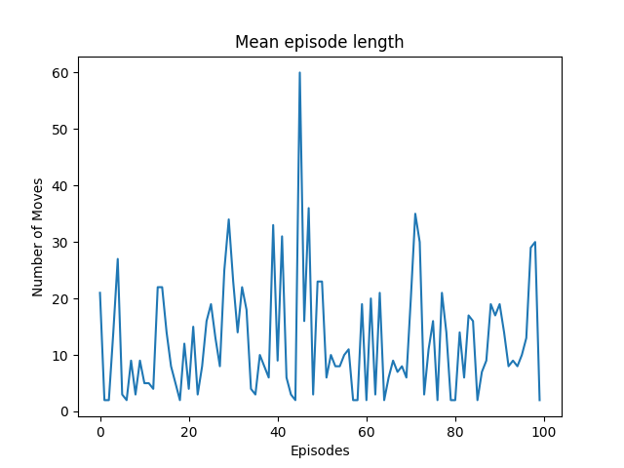
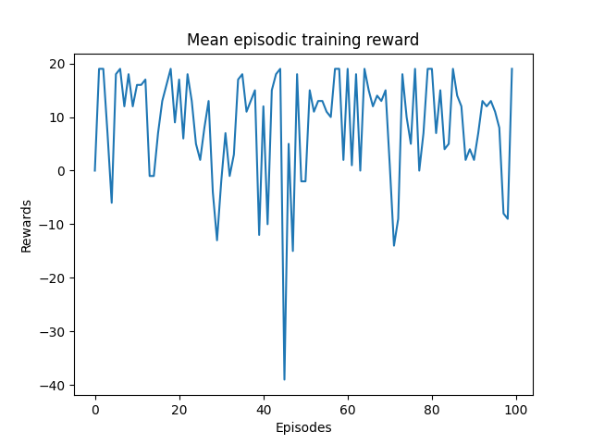
Initial Experiments I
We started with a board of 4x4 with 4 black pieces:
Reward:
Sparse Reward
-1 for each step while game continues
+20 completes the game
Agent:
Random Agent
Results:
Tested on 100 games
Mean moves made: 12.54
Mean reward received: 8.46
Fig.3 Random Agent
Fig.4 Mean Moves Made Graph Using Random Agent
Fig.5 Mean Reward Received Graph Using Random Agent

Slide 5
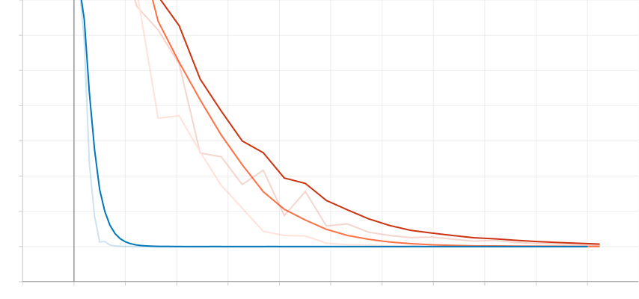
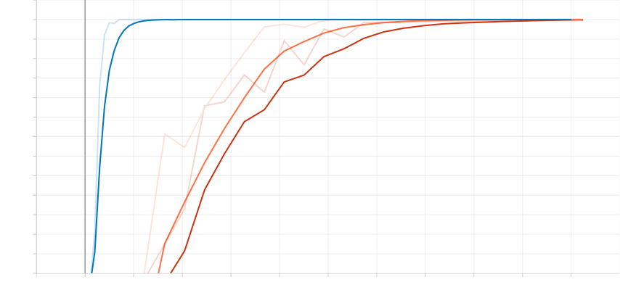
Initial Experiments II
Using trained model to play the game:
Models:
Proximal Policy Optimization (PPO)
Advantage Actor Critic (A2C)
Trust Region Policy Optimization (TRPO)
Reward:
Sparse Reward
-1 for each step while game continues
+20 completes the game
Policy:
MLP Policy
Time Steps:
50 000 steps
Results:
All models were able to solve the game easily
A2C better efficiency → converged to the optimal solution quicker
Fig.6 Mean Moves Made Graph Using Trained Agent on 4x4 Board
A2C
PP0
TRPO
Fig.7 Mean Reward Received Graph Using Trained Agent on 4x4 Board

Slide 6
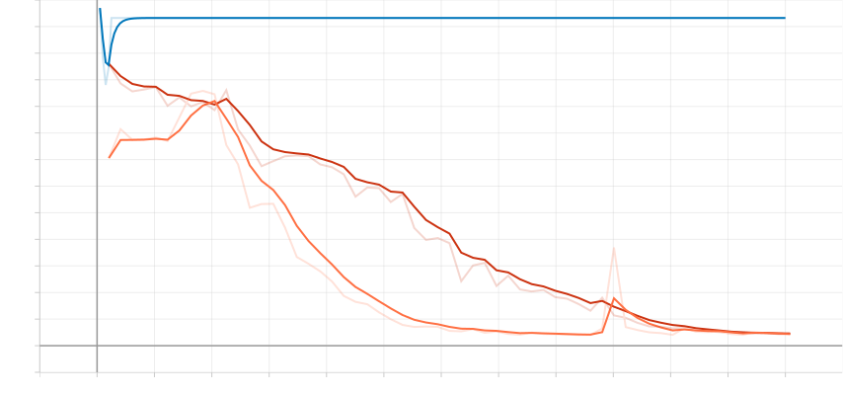
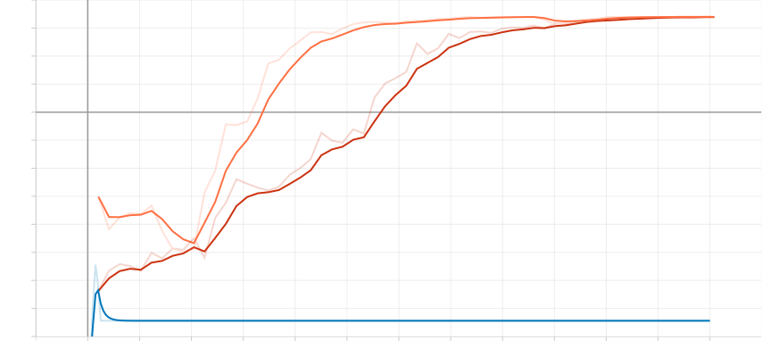
Experiment Using More Complex Game I
We increased the complexity of the game to a 5x5 board, using the same Models, Policy and Rewards:
Time Steps:
120 000 steps
Results:
Both PPO and TRPO were able to solve the game
A2C was not able to solve the game (may be use other rewarding strategy)
Reason:
Every time the agent chooses a invalid move, that state will not change and no reward will be given
Interestingly, the A2C agent will start selecting these invalid moves, which would lead to this awkward scenario showed in fig. 8 and fig. 9
Fig.8 Mean Moves Made Graph Using Trained Agent on 5x5 Board
A2C
PP0
TRPO
Fig.10 TRPO Solving
5x5 Board
Fig.9 Mean Reward Received Graph Using Trained Agent on 5x5 Board

Slide 7
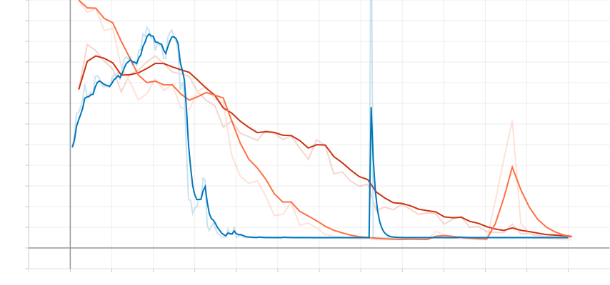
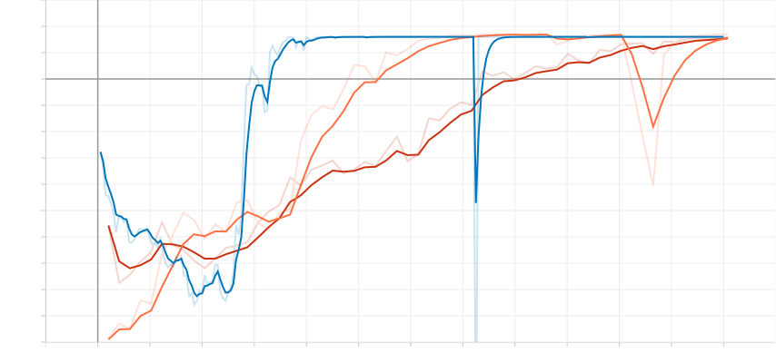
Experiment Using More Complex Game II
Solution to the problem:
By identifying the problem, we changed our reward function, also giving -1 to invalid moves
Further Experiments:
Increasing the board size to 6x6 showed similar results, but the agents took more time (more episodes) to be able to reach the optimal solution
We also tried applying reward shaping, so that it would increase the efficiency of the agents to achieve the optimal solution, by rewarding score each time the maximum connected pieces (global variable) is increased, encouraging the pieces to connect, however it did not show much improvement and for some cases it caused ‘misleading signals’ to the A2C agent
We also tried out by changing the values of the parameters passed to the models such as learning_rate, gamma (discounting factor)... However the results were not as good compared to the default ones
Fig.11 Mean Moves Made Graph Using Trained Agent on 5x5 Board (Solution to A2C)
A2C
PP0
TRPO
Fig.12 Mean Reward Received Graph Using Trained Agent on 5x5 Board (Solution to A2C)

Slide 8
Conclusions
Comparing the 3 models used:
A2C has a better efficiency compared to the other 2, however it also showed more uncertainty as the game complexity increased, while the other 2 could always get to the optimal solution by increasing the training time steps, this is due to making use of a trust region to minimize that problem by avoiding too large update.
Ways to improve:
Since this was a simplified version of the original game, we could improve this project by restoring it to the original game.
Improve and redesign a more adequate reward function
Exploring out other RL models, algorithms policies

Slide 9
Implemented Work:
Programming Language:
Developed in Python 3, using:
Open AI Gym
Numpy
Stable Baselines 3
Pygame
TensorBoard
Matplotlib
Development Environment:
Visual Studio Code,
Miniconda
PyCharm
Python Interpreter 3.10.4
Git
Data Structure:
Board representation using numpy array
Bibliography:
[1] OpenAI Gym Official Documentation https://www.gymlibrary.ml/
[2] Lines of Action https://www.boardspace.net/loa/english/index.html
[3] An introduction to Reinforcement Learning
https://www.youtube.com/watch?v=JgvyzIkgxF0
[4] A friendly introduction to deep reinforcement
learning, Q-networks and policy gradients
https://www.youtube.com/watch?v=SgC6AZss478
[5] Stable Baselines 3 Documentation
https://stable-baselines3.readthedocs.io/en/master/
[6] Numpy Documentation
https://numpy.org/doc/stable/index.html

